Slide 1
CS 2114 - Data Structures & Software Design
Week 3 day 1

Slide 2
CS2114 Office Hours
TA office hours are in Torg 1070
Log in to My Digital Hand, add your name and photo!
You should have received an email invite
Use My Digital Hand to line up once you arrive to Torg
Describe what you need help with in detail
Keep your browser open to MDH and keep your volume on
Pay attention so that you know when it is your turn!
CS2114 TAs should be on the far left of the room when you walk in

Slide 3
Class Business
Canvas Calendar – Week 3 Schedule
Lab 03 is due this week.
Work on Project 1
Peer+ credit for week 2 should be visible in canvas
Optional MC questions most weeks in Modules for extra practice/test prep

Slide 4
Lab 02 - Review
Employee emp1 = new Employee(param, param,..); Possible or Not Posible?
PartTimeEmployee pt1 = new Employee(param, param,..); Possible or Not Posible?
Employee emp2 = new PartTimeEmployee(param, param,..); Possible or Not Posible?
Also, packages are folders for grouping similar classes.
Note this can be useful for visibility modifiers… public, private, protected(child classes can access), and default is within the same package.
Notes:
We won’t use multiple packages in this class.

Slide 5
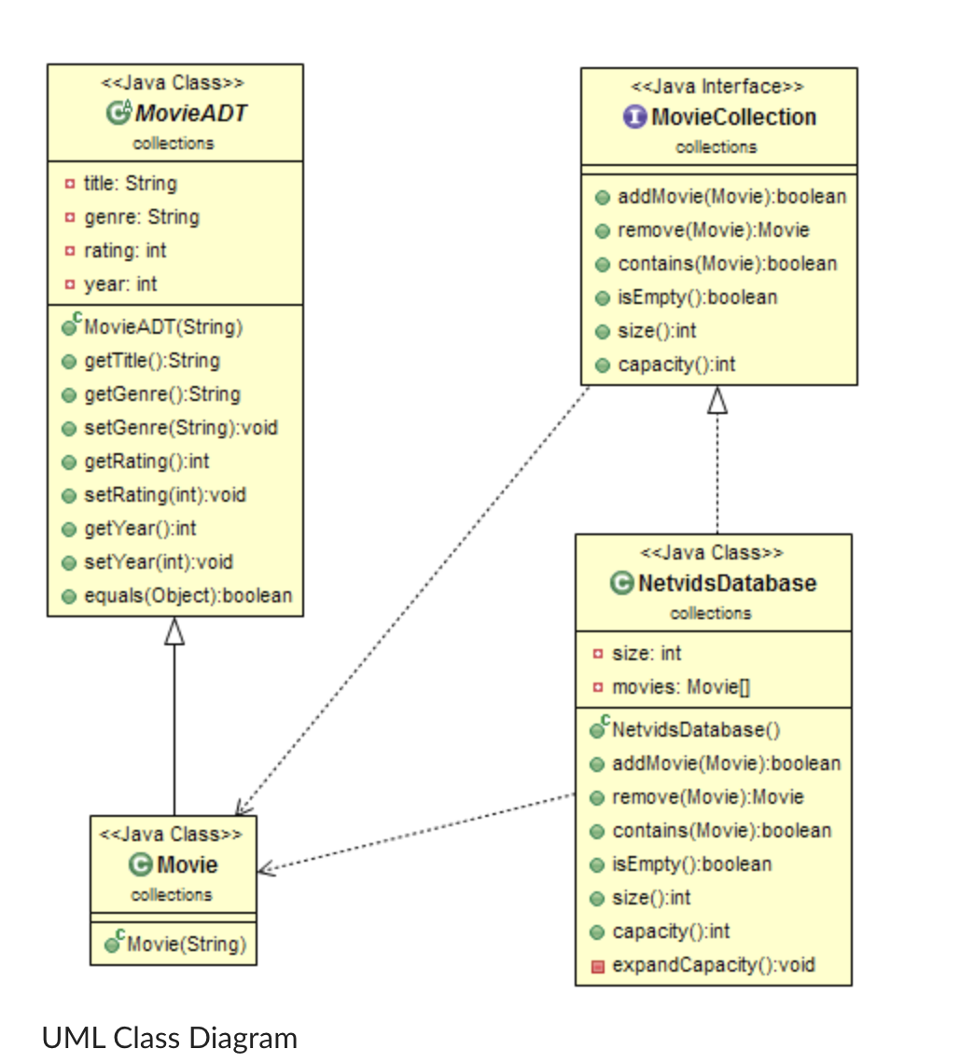
Lab 03 - Hints
Abstract Class
ADT vs Interface
Notes:
Contact us if you cannot submit to Web-CAT

Slide 6
Project 1 Guidance
Focus on setup of project
Finish the Bags content pages before starting project 1
Go through the example code for window class
Demo setup and output as needed
Project 1 instructions reference Testable Random documentation: https://courses.cs.vt.edu/~cs1114/api/student/TestableRandom.html
Notes:
as needed based on week 2

Slide 7
Why We Use Peer Instruction
Research shows better student learning and satisfaction from active learning
Twice the learning gains in Physics
Half grade improvement in Computer Science
Instructor displays hard multiple-choice question
Students vote individually
Discuss with peers
Students vote individually again
Instructor leads a discussion
Figure out your group of 3-4 students and move around as needed

Slide 8
Tips for a good group discussion
Take turns being the first one to talk
Once you all agree on the answer, don’t stop!
Always go over each wrong answer and explain why it is wrong
Also interesting and useful to think about why somebody might be tempted to choose it—why was that wrong answer included?
Even if your group-mate has said something very clearly and correctly, it’s a good idea to repeat it yourself
“So, what I think you said was, …”
Might seem pointless, but your brain will remember better if YOU say it too

Slide 9
Week 3 Day 1 Peer +
Notes:
Go around the class and discuss Q5, Q6, Q7, Q8, Q9

Slide 10
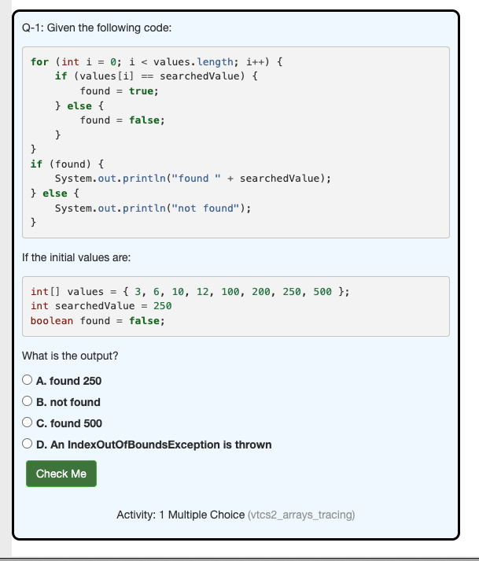

Slide 11
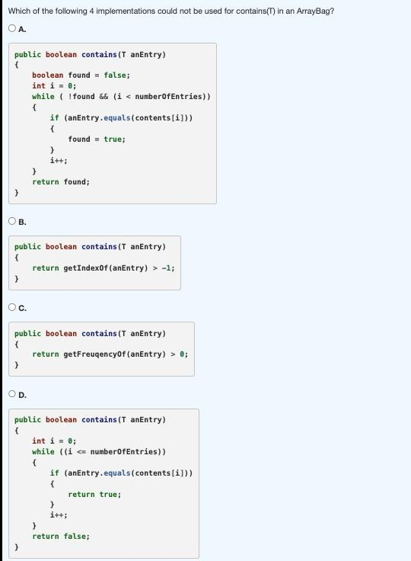
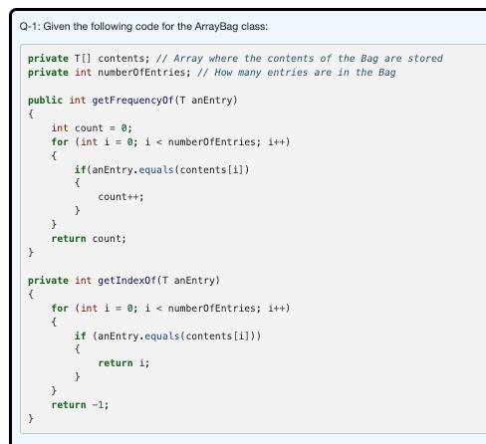

Slide 12
Python Tutor Demo - Object References
In eclipse, can download ObjectReferencesDemo (use blue down arrow)
Open pythontutor.com, choose Java
Paste the Employee class in
Trace code using Next button

Slide 13
CW – Week 3
Notes:
Let them work on questions. Go around the lab.

Slide 14
Code Workouts – Q1
X670: Turn Bag to Set
Notes:
Move to Codeworkout to explain the problem and comeback to discuss solution

Slide 15
Code Workouts – Q1
This arrayBag is of a fixed length. It will not have the expandCapacity method available. Once the bag is full, nothing else can be added. //SIZE
How to implement it?
HINT: Which method can help?
Notes:
Solution: if (numberOfEntries == contents.length) { //Size
return false;
}

Slide 16
Code Workouts – Q1
When invoked the method takes the T parameter anEntry and determines if anEntry already exists in the bag. // CHECK DUPLICATES
If the bag does not already contain anEntry then the method attempts to add it to the bag, and return true.
If the bag already contained anEntry the method does not attempt to add anEntry and returns false.
Remember to review the Bags module, specifically the add() method implementation for Bags as it will be helpful here.
Notes:
for (int i = 0; i < numberOfEntries; i++) {
if (contents[i].equals(anEntry)) {//Content Duplicates
return false;
}
}
contents[numberOfEntries] = anEntry;
numberOfEntries++;
return true;

Slide 17
Next Class
Lab 03 is due this week. - Please submit Lab 3 to webCAT using Eclipse and if facing any issues contact any TA. Post Lab 03 is also due this week.
Start doing project 1.
Labs are Mandatory.
We will use piazza heavily. You can filter to select for Instructor posts so you don’t miss any announcements.

Slide 18

Thanks
Notes:
Show them code workout questions

